Slide 1
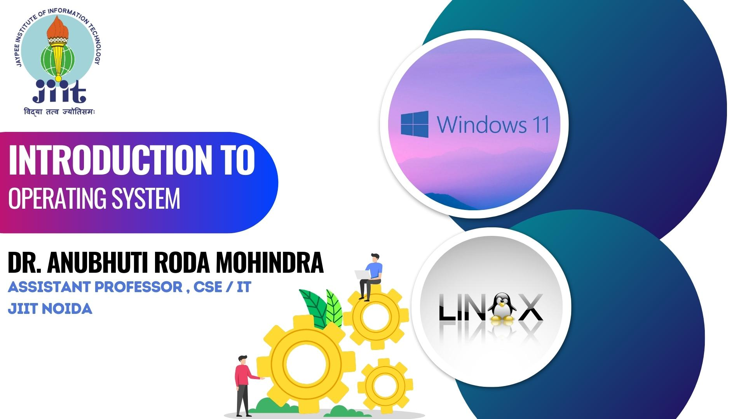

Slide 2
What is an Operating System?
Computer System = Hardware + Software
An Operating System is a system Software that acts as an intermediary/interface between a user of a computer and the computer hardware.
System Calls

Slide 3
Computer System Components
Hardware
Provides basic computing resources (CPU, memory, I/O devices).
Operating System
Controls and coordinates the use of hardware among application programs.
Application Programs
compilers, database systems, video games, business programs such as banking software.
Users
People, machines, other computers

Slide 4
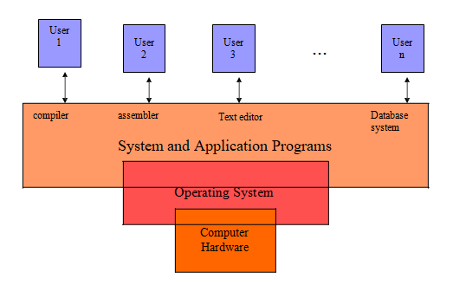
Abstract View of System

Slide 5
Parts of OS
Shell –Outer part responsible of interacting with the operating system.
Kernel – Central component responsible for managing and controlling computer resources.

Slide 6
GOALS
CONVENIENCE
Windows (80%)
THROUGHPUT
LINUX
MAC

Slide 7

The function of Operating System is to :
Take information as input
Display the result as output
Manage and control parts of computer
All of these

Slide 8

The function of Operating System is to :
Take information as input
Display the result as output
Manage and control parts of computer
d) All of these

Slide 9
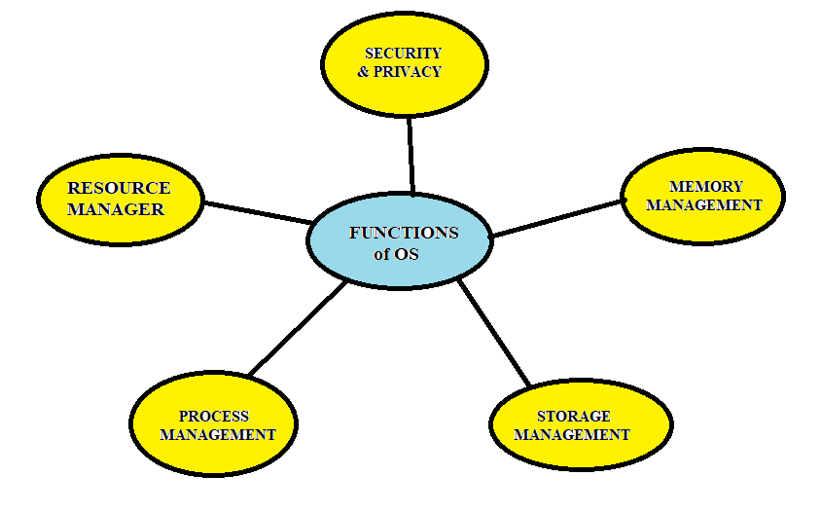

Slide 10
FUNCTIONS
Resource Manager
Manages resources (software and hardware) efficiently.
Process Management
Manages different processes on CPU (CPU Scheduling)
Storage Management
Manages hard disk (not limited) with file system

Slide 11
Memory Management
Manages RAM (limited)
File Management
Manages files.
Security and Privacy
System authentication
Inter-process communication

Slide 12
Why should I study Operating Systems?
Understand interaction between hardware and applications
New applications, new hardware
Understand design of computer systems
efficient resource management, security, flexibility
Increasing need for specialized operating systems
embedded OS
real-time OS

Slide 13

Which of these are Real time OS ?
CENTOS
IOS
FreeRTOS
RTLinux

Slide 14

Which of these are Real time OS ?
CENTOS
IOS
FreeRTOS (used by AMAZON)
eCos (open source)

Slide 15
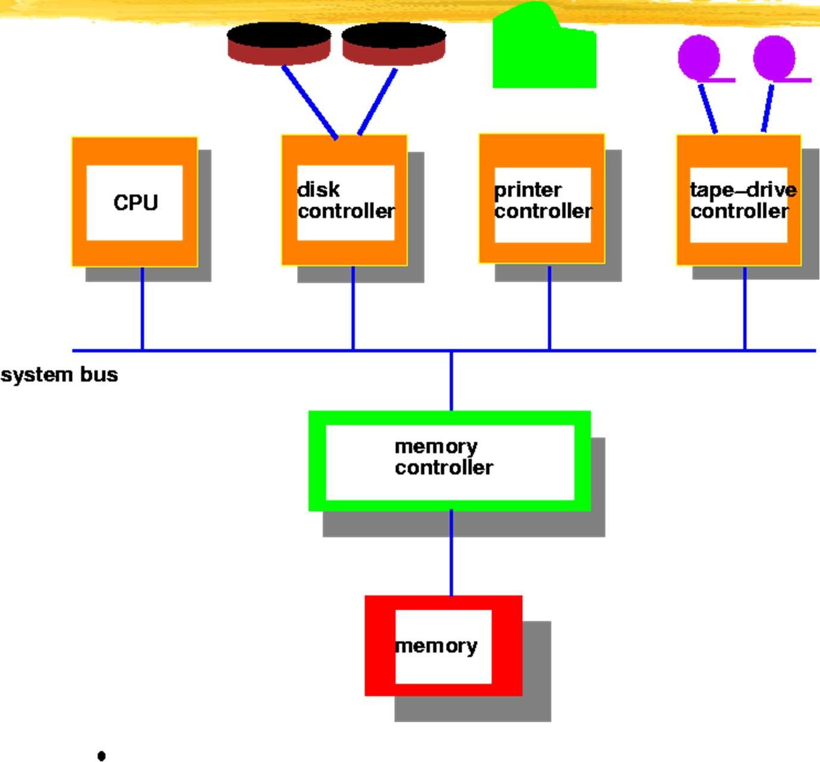
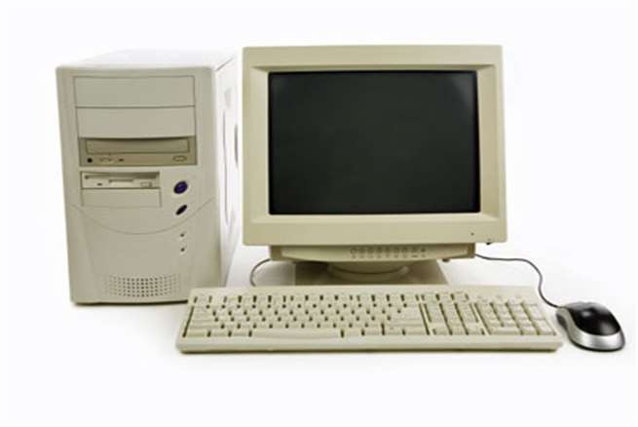
Computer System Architecture (traditional)

Slide 16
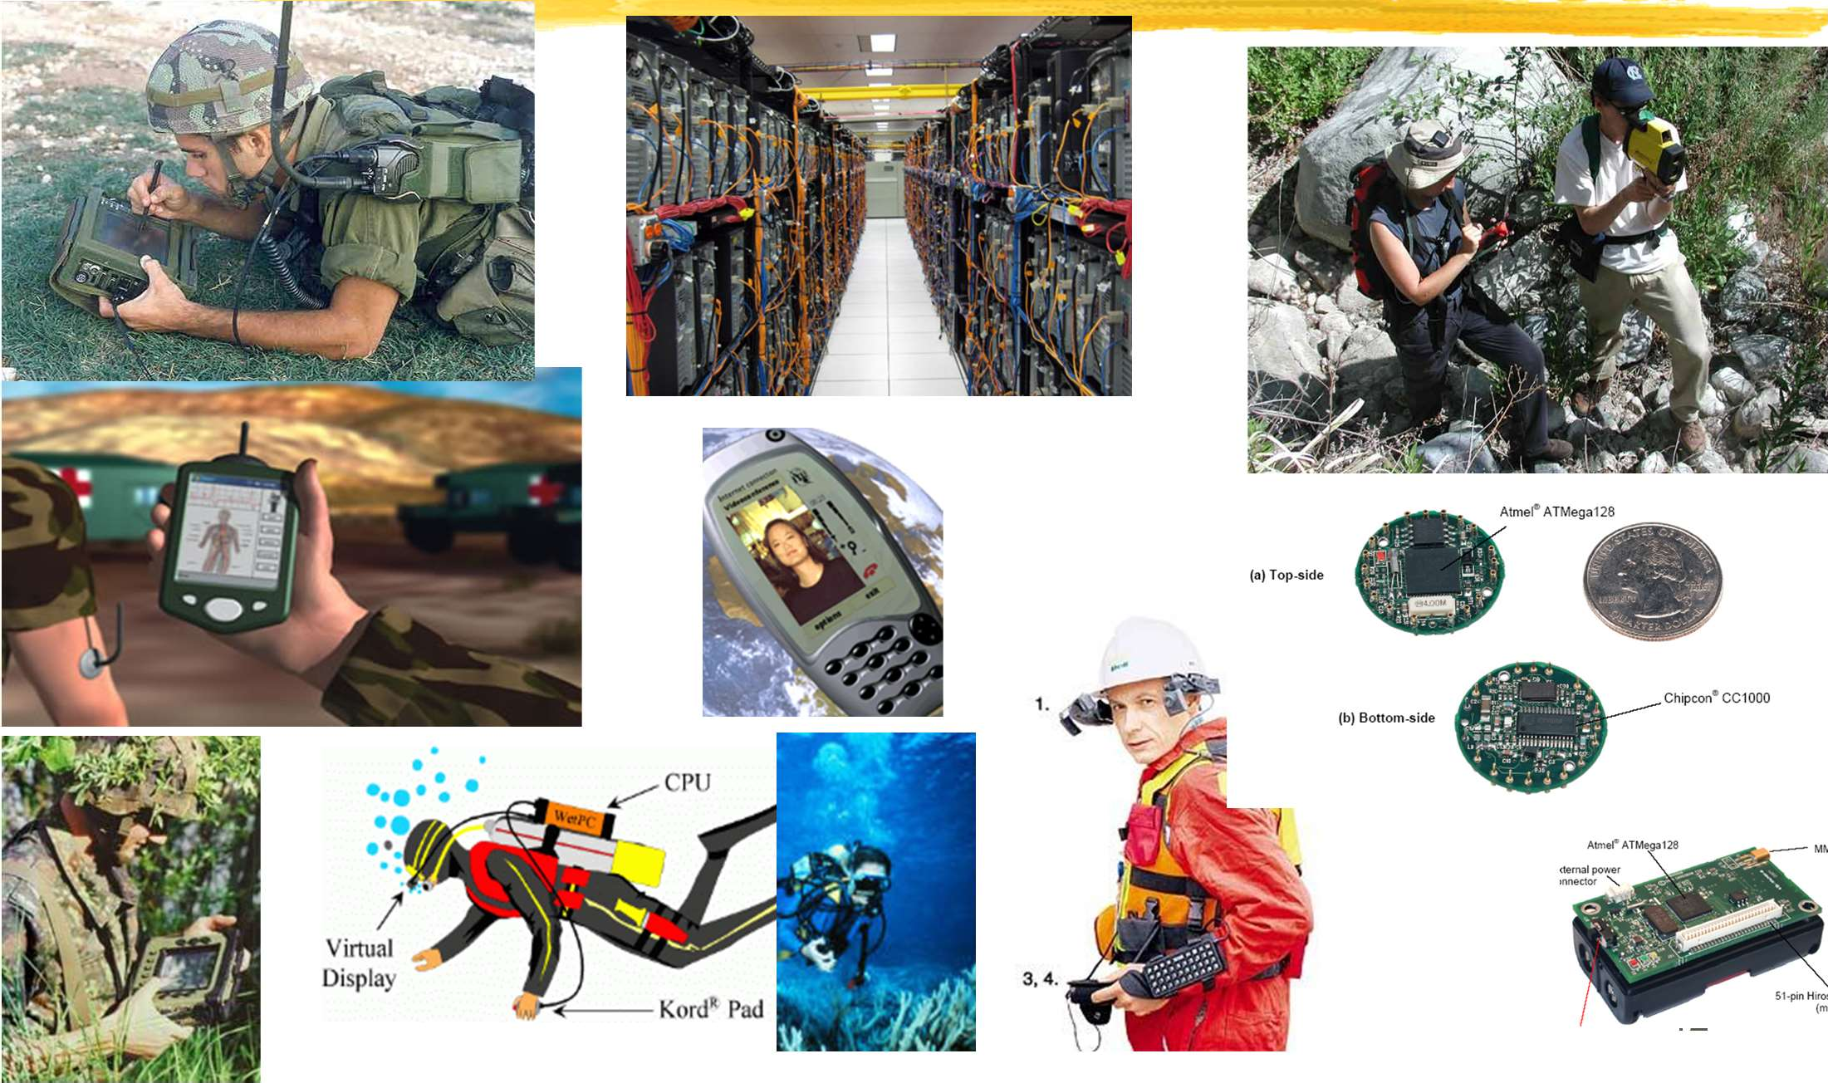
Systems Today
12

Slide 17
Operating System Spectrum
Monitors and Small Kernels
special purpose and embedded systems, real-time systems
Batch and multiprogramming
Timesharing
workstations, servers, minicomputers, timeframes
Transaction systems
Personal Computing Systems
Mobile Platforms

Slide 18

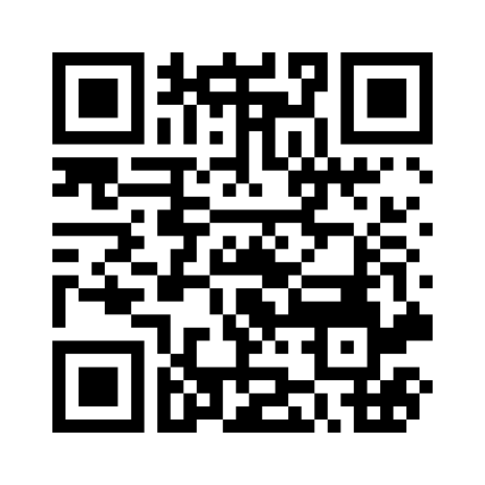
https://www.menti.com/ala787n12ttr

